Slide 1
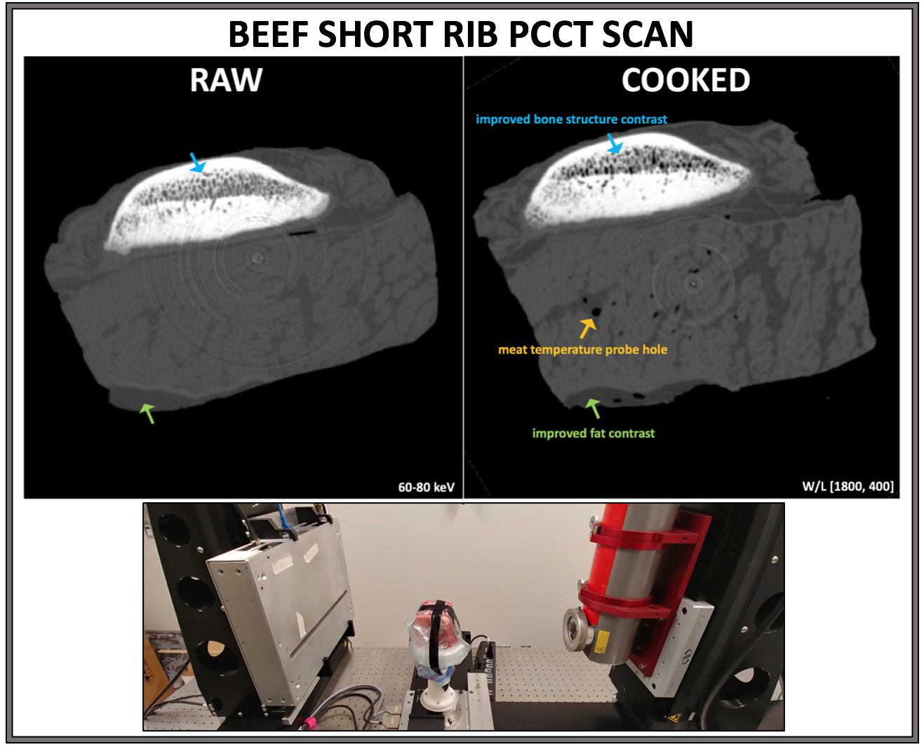
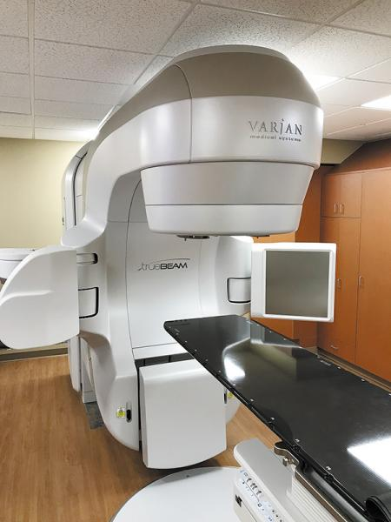

Devon Richtsmeier
PhD candidate, Medical Physics
Project: Photon-counting computed tomography for imaging of gold nanoparticles for drug delivery

Slide 2
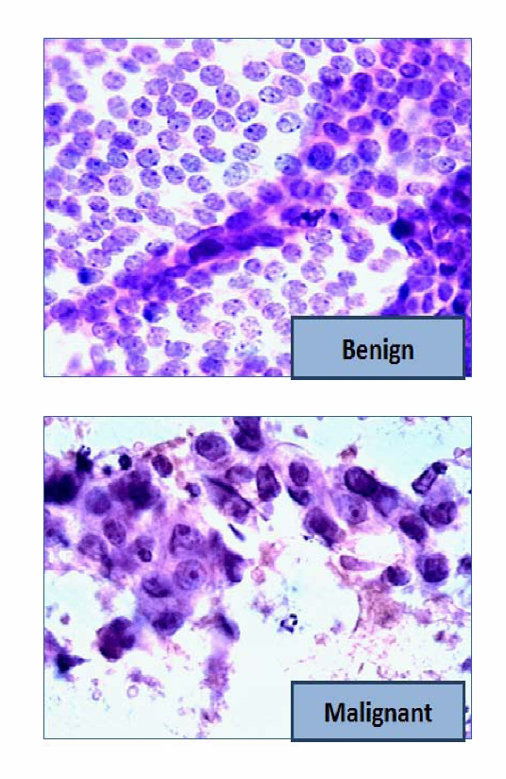
Classification Data
Breast cancer tumor data:
Data taken from the UCI Machine Learning Repository and is from the University of Wisconsin
Features are computed from an image of a fine needle aspirate (FNA) (a type of biopsy) of a breast mass
Features describe various cell nuclei characteristics
Fine needle aspirate: a thin needle is used to gather a sample of cells, tissue, or fluid from a suspected cancerous area
Samples are viewed by a pathologist under a microscope
Potential issues:
The needle may miss the mass or lump
The pathologist may miss one or two cells that could be important
Malignant vs. Benign
Ahmad et al. 2013 13th International Conference on Intelligent Systems Design and Applications.

Slide 3
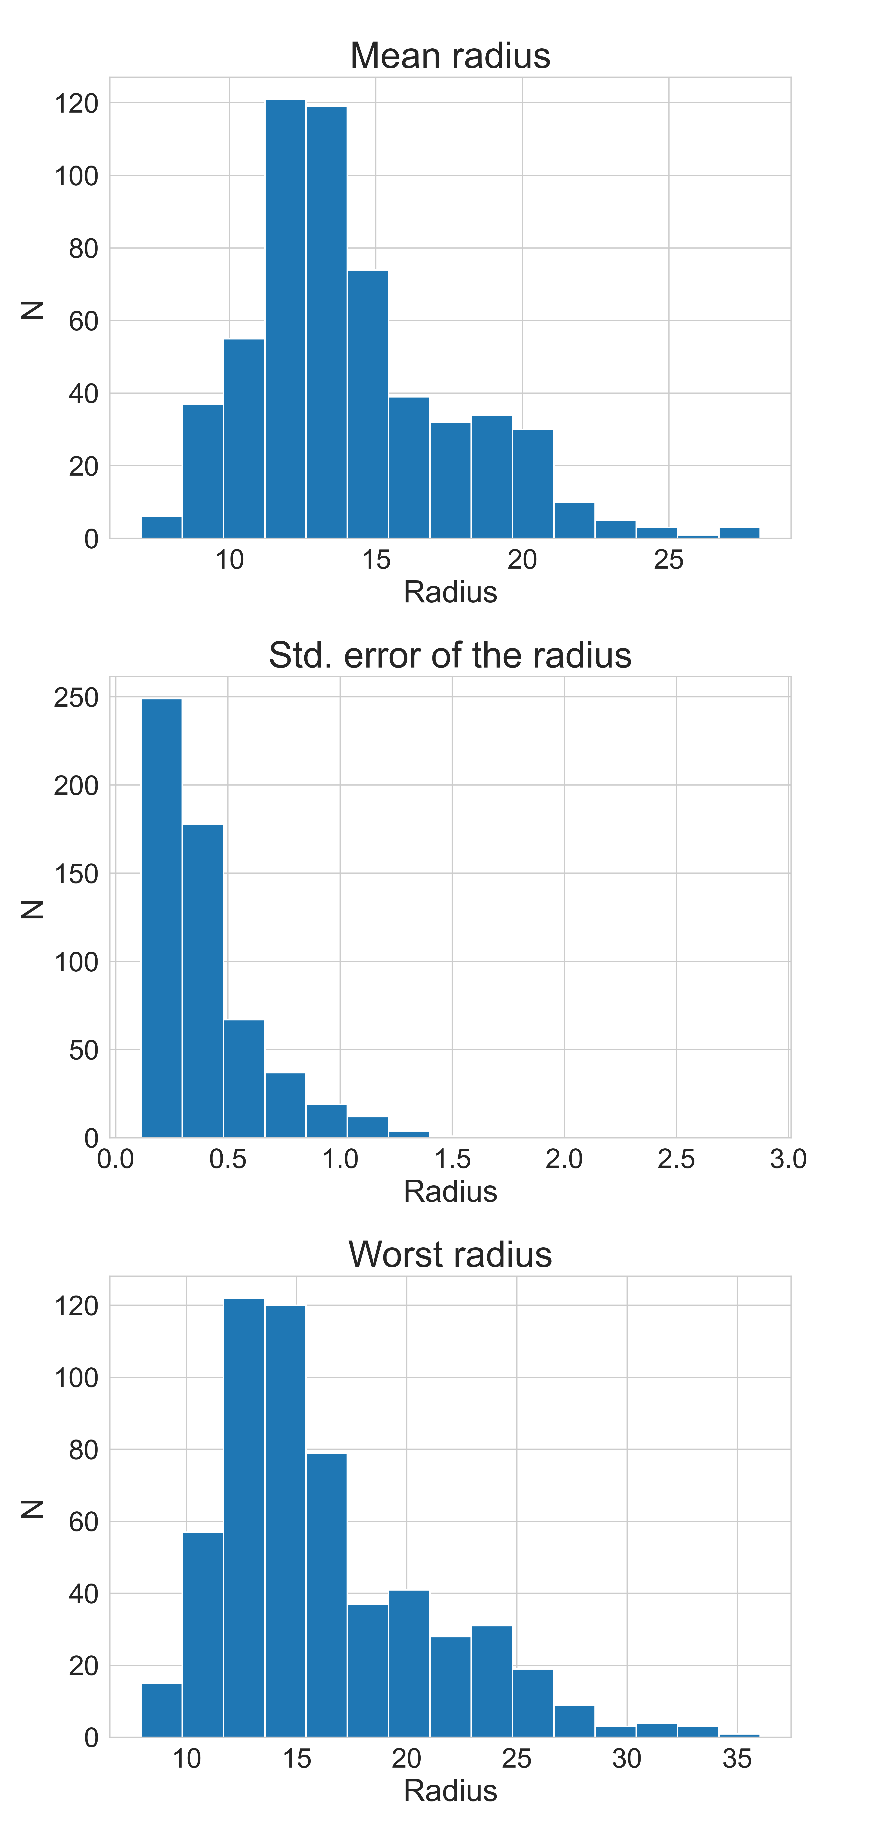
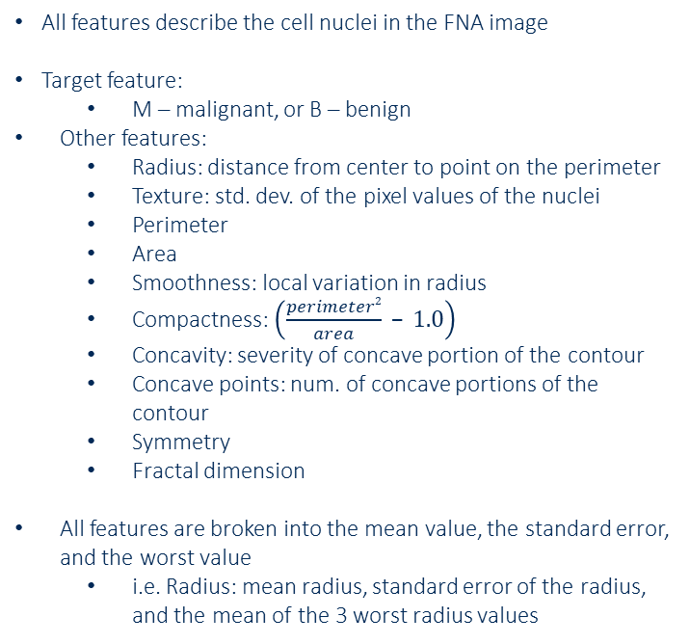
Classification Data
Breast cancer tumor data:
All features describe the cell nuclei in the FNA image
Target feature:
M – malignant, or B – benign
Other features:
Radius: distance from center to point on the perimeter
Texture: std. dev. of the pixel values of the nuclei
Perimeter
Area
Smoothness: local variation in radius
Compactness: $\left(\frac{perimeter2}{area} – 1.0\right)$
Concavity: severity of concave portion of the contour
Concave points: num. of concave portions of the contour
Symmetry
Fractal dimension
All features are broken into the mean value, the standard error, and the worst value
i.e. Radius: mean radius, standard error of the radius, and the mean of the 3 worst radius values

Slide 4
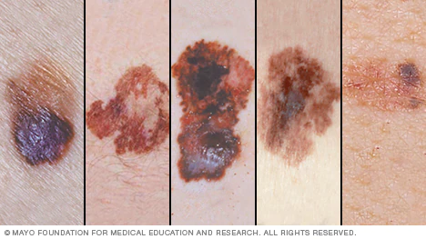
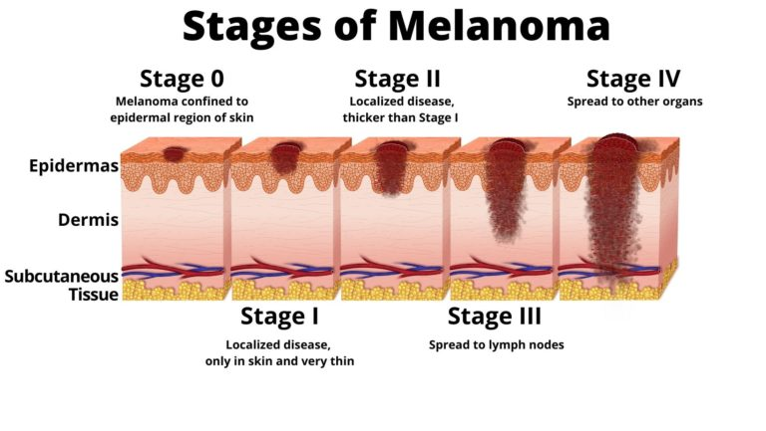
Regression Data
This data is a set from a MachineHack Hackathon #15
Melanoma is the most serious type of skin cancer due to its propensity to metastasize
ABCDEs of melanoma (what you should look for)
Asymmetry
Border
Color
Diameter
Evolution – how it’s changed over time
Doctor evaluation
Full body skin exam
Pictures
Biopsy of suspected area
Beneficial to evaluate tumor size from skin measurements
https://www.aimatmelanoma.org/stages-of-melanoma/

Slide 5
Regression Data
Melanoma tumor data: 9,146 cases
Target feature:
Tumor size
Other features:
Mass of the area under study
Size of the area under study
Ratio of normal to malign skin in the area
The area of damaged skin
The total area exposed to the tumor
Std. dev. of malign skin measurements
Error of the malign skin measurements
Penalty applied due to measurement error in the lab
Ratio of damage to total spread on the skin

